Slide 1
TELECOM CHURN DATA SCIENCE PROJECT
Solving Customer Churn with Predictive Modeling
Submitted by : Group No - 2
Date : 06 - 05 -2024

Slide 2
BUSINESS OBJECTIVE
Addressing Customer Churn In The Telecommunications Industry
Telecom companies face annual churn rates exceeding 10%, posing a significant challenge.
Project goal: Develop a classification model to predict customer churn based on individual features.
Aim to create a predictive model to identify at-risk customers and implement effective retention strategies.

Slide 3
Data Set Details: Each row corresponds to a client of a telecommunications company for whom it has collected information about the type of plan they have contracted, the minutes they have talked, or the charge they pay every month.
The data set includes the following variables

Slide 4
state: Categorical, for the 51 states and the District of Columbia.
Area.code
account.length: how long the account has been active.
voice.plan: yes or no, voicemail plan.
voice.messages: number of voicemail messages.
intl.plan: yes or no, international plan.
intl.mins: minutes customer used service to make international calls.
intl.calls: total number of international calls.
intl.charge: total international charge.
day.mins: minutes customer used service during the day.
day.calls: total number of calls during the day.
day.charge: total charge during the day.
eve.mins: minutes customer used service during the evening.
eve.calls: total number of calls during the evening.
eve.charge: total charge during the evening.
night.mins: minutes customer used service during the night.
night.calls: total number of calls during the night.
night.charge: total charge during the night.
customer.calls: number of calls to customer service.
churn: Categorical, yes or no. Indicator of whether the customer has left the company (yes or no).

Slide 5
Let's break down the key components and steps involved to solved this project.
1 importing the libraries
2 Data description (descriptive statistics)
3 EDA (Data preprocessing, convert categorical data, missing values, duplicates, encoding, outlier detection, univariate analysis, Bivariate analysis, multivariate analysis, Feature engineering)
6 Model building
7 Model Training
8 Model Evaluation
9 Feature importance
10 inference and actionable insights
11 Deployment.

Slide 6
Importing Libraries
import numpy as np
import pandas as pd
Importmatplotlib.pyplot as plt
import seaborn as sns
import streamlit as st
import category_encoders as ce
from sklearn.model_selection import train_test_split
from imblearn.over_sampling import SMOTE
from sklearn.linear_model import LogisticRegression
from sklearn.tree import DecisionTreeClassifier, plot_tree
from sklearn.neighbors import KNeighborsClassifier
from sklearn.svm import SVC
from sklearn.ensemble import RandomForestClassifier

Slide 7
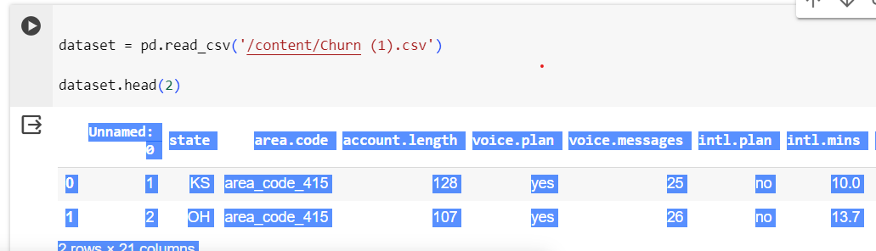
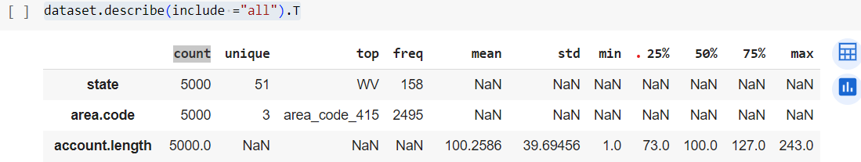
2 Data description (descriptive statistics) Descriptive statistics provide a summary of the main characteristics of a dataset. These statistics help to understand the distribution, central tendency, and variability of the data. Typically, descriptive statistics include the following steps:
Load Data
Removing unnecessory Data
dataset =dataset.drop(['Unnamed: 0'],axis =1 )
dataset.describe(include ="all").T

Slide 8
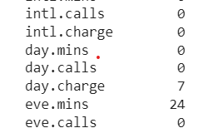
3 EDA Exploratory Data Analysis (EDA) involves a series of steps to understand and summarize the main characteristics of a dataset. These steps help in uncovering patterns, trends, relationships, and anomalies in the data. Here are the typical steps involved in EDA:
Convert categorical data to float
# Convert 'day.charge' column to float
dataset['day.charge'] = pd.to_numeric(dataset['day.charge'], errors='coerce')
# Convert 'eve.mins' column to float
dataset['eve.mins'] = pd.to_numeric(dataset['eve.mins'], errors='coerce')
# Convert 'churn' column to numeric using label encoding
dataset['churn'] = dataset['churn'].map({'no': 0, 'yes': 1})
dataset.info()
Missing Values
dataset.isna().sum()

Slide 9
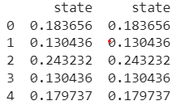
Duplicates
dataset[dataset.duplicated()]
# no duplicates values
Encoding for categorical variables.
# Initialize TargetEncoder
target_encoder = ce.TargetEncoder()
# Apply target encoding to the 'state' column
dataset['state'] = target_encoder.fit_transform(dataset['state'], dataset['churn'])
# Display the first few rows to verify the encoding
print(dataset[['state', 'state']].head())
# Encode categorical variables
from sklearn.preprocessing import LabelEncoder, StandardScaler
label_encoder = LabelEncoder()
dataset['voice.plan'] = label_encoder.fit_transform(dataset['voice.plan'])
dataset['intl.plan'] = label_encoder.fit_transform(dataset['intl.plan'])
dataset['churn'] = label_encoder.fit_transform(dataset['churn'])
dataset.head(3)

Slide 10
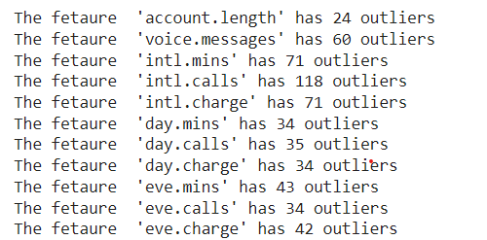
Outlier Detection
def outliers (dataset,ft):
outlier_dict = {}
Q1=dataset[ft].quantile(0.25)
Q3=dataset[ft].quantile(0.75)
IQR= Q3-Q1
LOWER_BOUND=Q1-1.5*IQR
UPPER_BOUND=Q3+1.5*IQR
ls=dataset.index[ (dataset[ft]< LOWER_BOUND) | (dataset[ft]> UPPER_BOUND) ]
outlier_dict[ft]=ls
return outlier_dict
def info(your_dict:dict)->None:
for feature_name, indices_list in your_dict.items():
print(f"The fetaure '{feature_name}' has {len(indices_list)} outliers")
for outlier_dict in index_list:
info(outlier_dict)

Slide 11
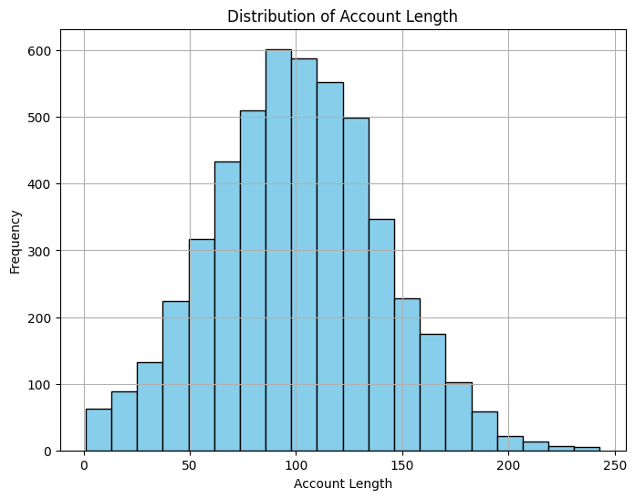
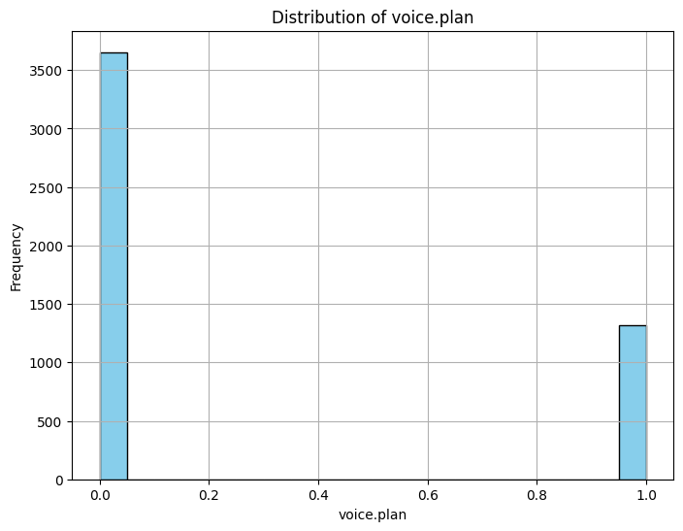
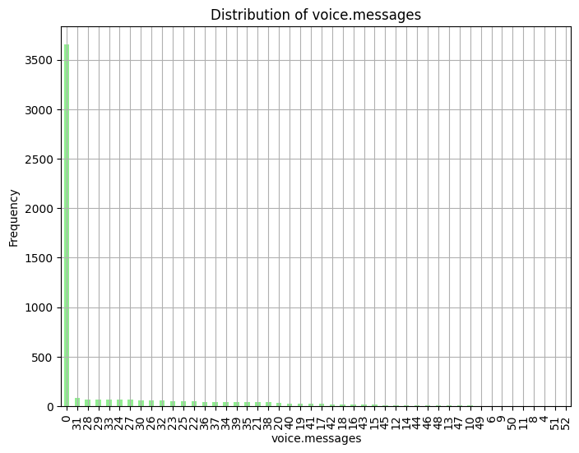
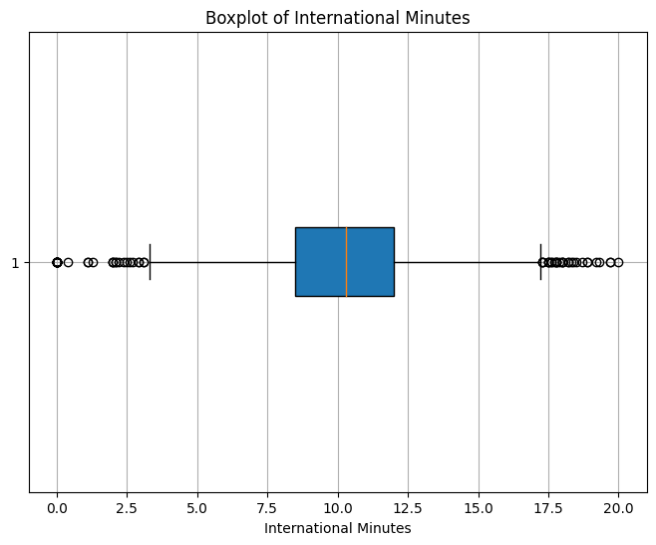
Univariate Analysis

Slide 12
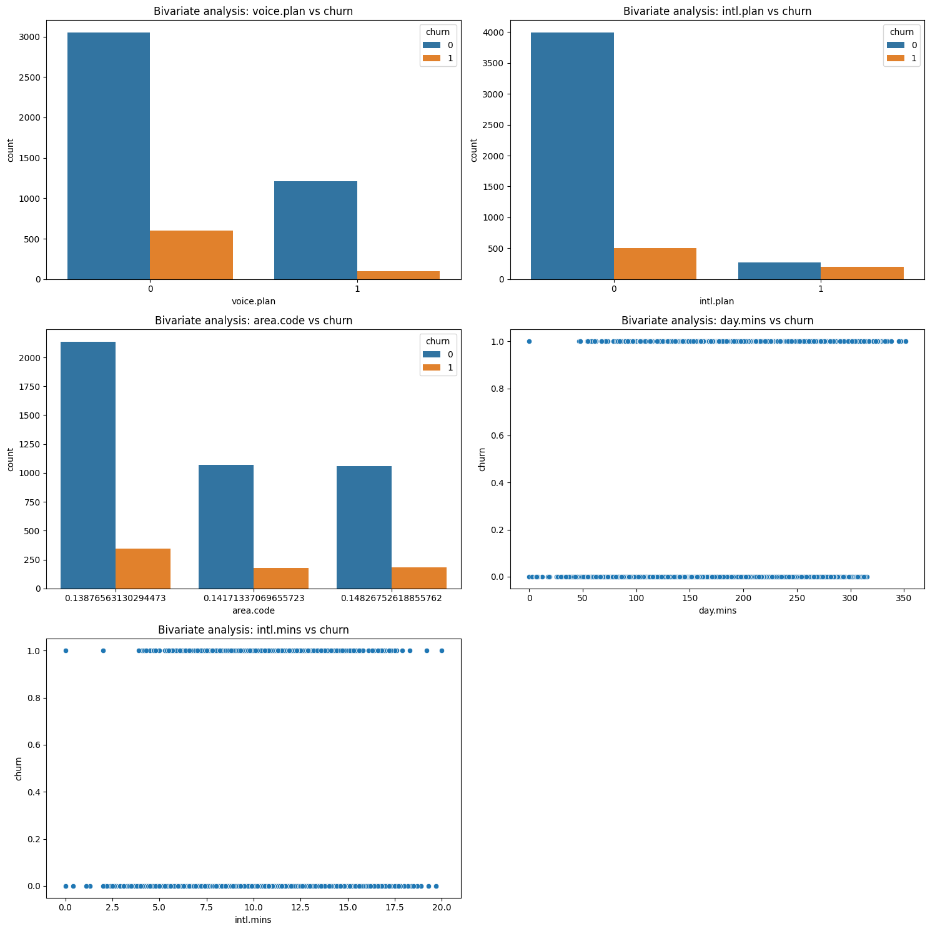
Bivariate Analysis

Slide 13
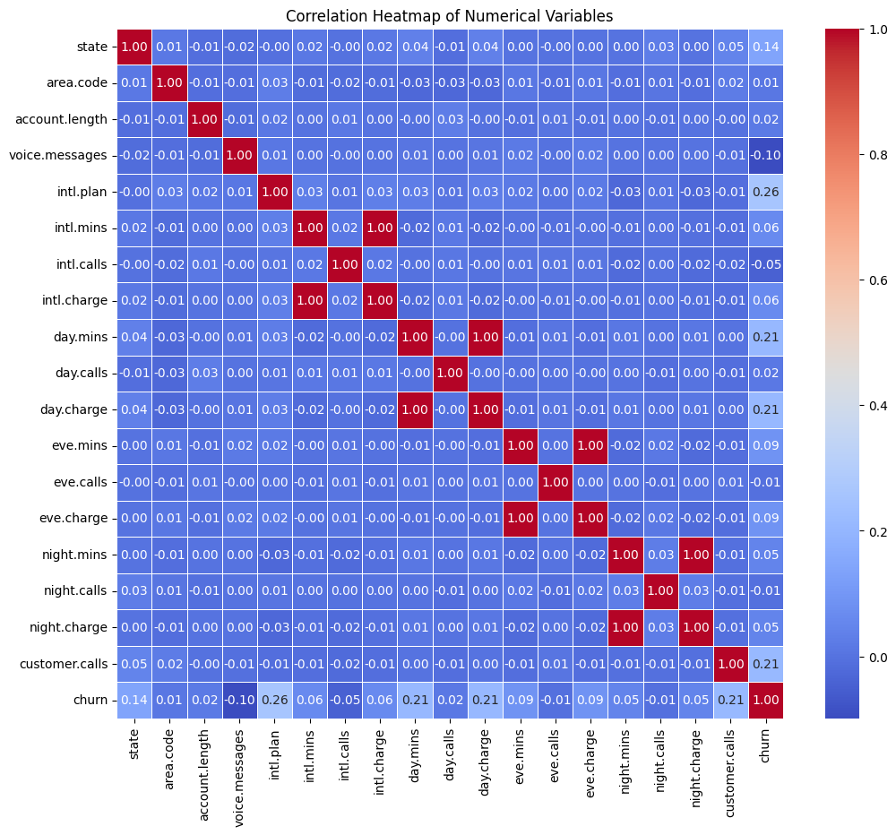
Multivariate Analysis
From this heatmap we come to knew that intl.mins, int.charge and day.mins , day.charge and eve.mins, eve.charge, and night.mins, night.charge have a very strong relation

Slide 14
Feature Engineering:
Creating new feature to reduce large number of variables.
# Assuming 'df' is your DataFrame
columns_to_drop = [ "eve.charge", "day.charge", "night.charge", "intl.charge", "intl.mins"]
# Drop the specified columns
dataset_filtered = dataset.drop(columns_to_drop, axis=1)
dataset=dataset_filtered
# Generate descriptive statistics for the remaining columns
dataset.describe().T

Slide 15
6 Model Building Train and Test split
# Splitting data into features and target variable
X = dataset.drop('churn', axis=1)
y = dataset['churn’]
# Model Training
from sklearn.model_selection import train_test_split
X_train, X_test, y_train, y_test = train_test_split(X, y, test_size=0.2, random_state=42
#Feature Engineering (Feature Scaling)
scaler = StandardScaler()
X_train_scaled = scaler.fit_transform(X_train)
X_test_scaled = scaler.transform(X_test)
X_train=X_train_scaled
X_test=X_test_scaled

Slide 16
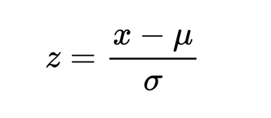
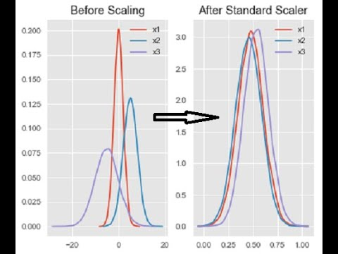
A simple standard scaler transforms features by subtracting the mean and dividing by the standard deviation, ensuring that the transformed features have a mean of 0 and a standard deviation of 1.
It is commonly used in machine learning pipelines to standardize numerical features, making them comparable and preventing certain features from dominating the model training process.

Slide 17
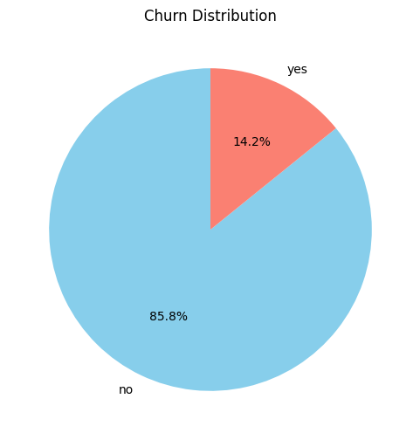
“ THE CLASSIFICATION NATURE OF THE PROJECT ”
“IMBALANCED DATA”
Imbalanced data poses challenges in accurately predicting minority class instances, leading to biased models.
Red flags include skewed class distributions and difficulty in generalizing predictive patterns for the minority class.
The imbalance in data to work around data leaks ,We resample the data using average sampling - “UPSample”.

Slide 18
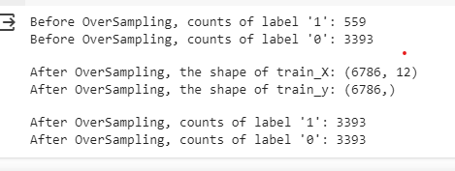
Handling the Imbalanced data with Over sampling
from imblearn.over_sampling import SMOTE
print("Before OverSampling, counts of label '1': {}".format(sum(y_train==1)))
print("Before OverSampling, counts of label '0': {} \n".format(sum(y_train==0)))
sm = SMOTE(random_state=2)
X_train_res, y_train_res = sm.fit_resample(X_train, y_train.ravel())
print('After OverSampling, the shape of train_X: {}'.format(X_train_res.shape))
print('After OverSampling, the shape of train_y: {} \n'.format(y_train_res.shape))
print("After OverSampling, counts of label '1': {}".format(sum(y_train_res==1)))
print("After OverSampling, counts of label '0': {}".format(sum(y_train_res==0)))

Slide 19
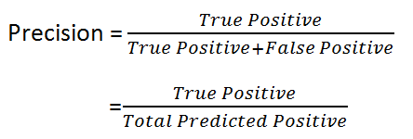
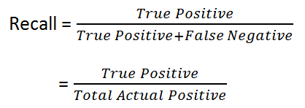

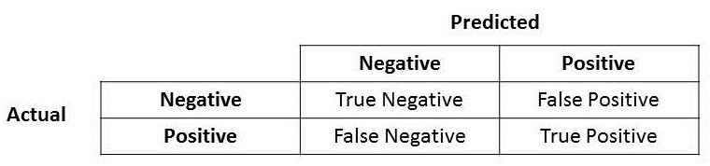
Evaluation Metrics
Precision can be seen as quality of Prediction wheres as Recall measures the quantity .

Slide 20
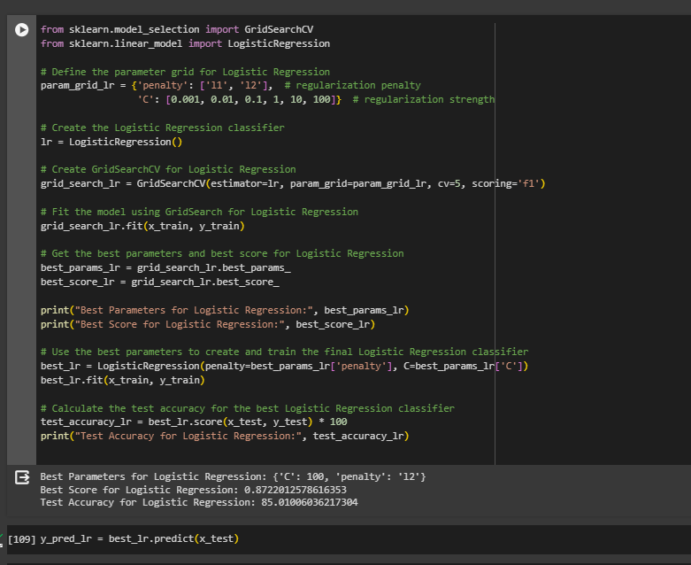
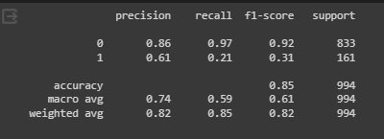
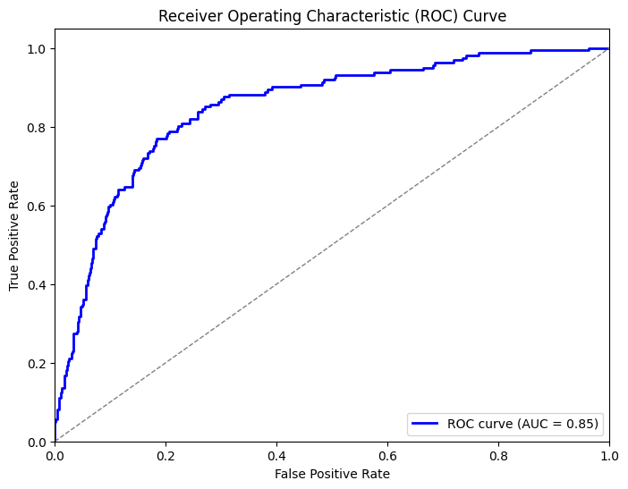
(1) Logistic Classifier

Slide 21
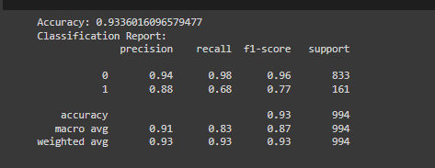
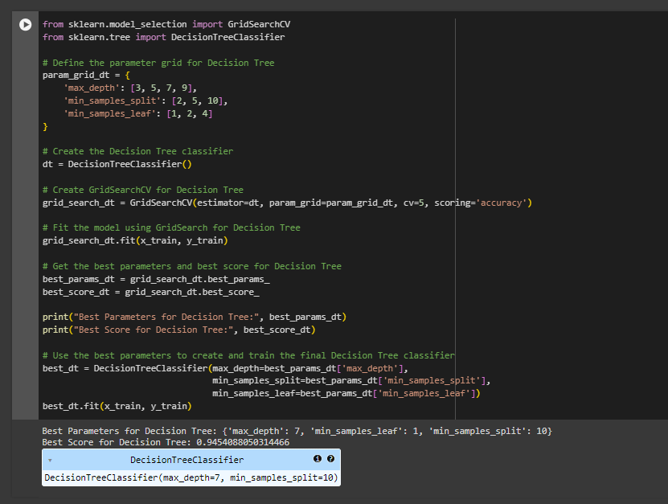
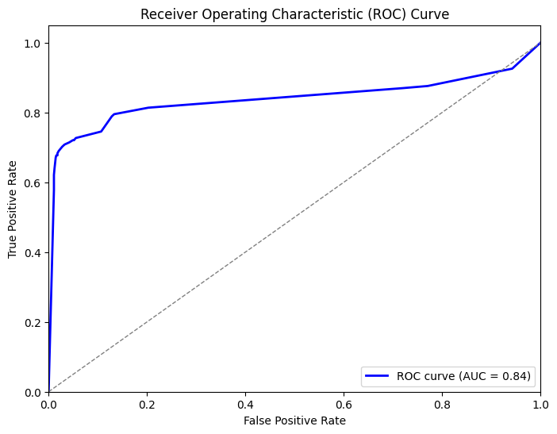
(2) Decision Tree Classifier

Slide 22
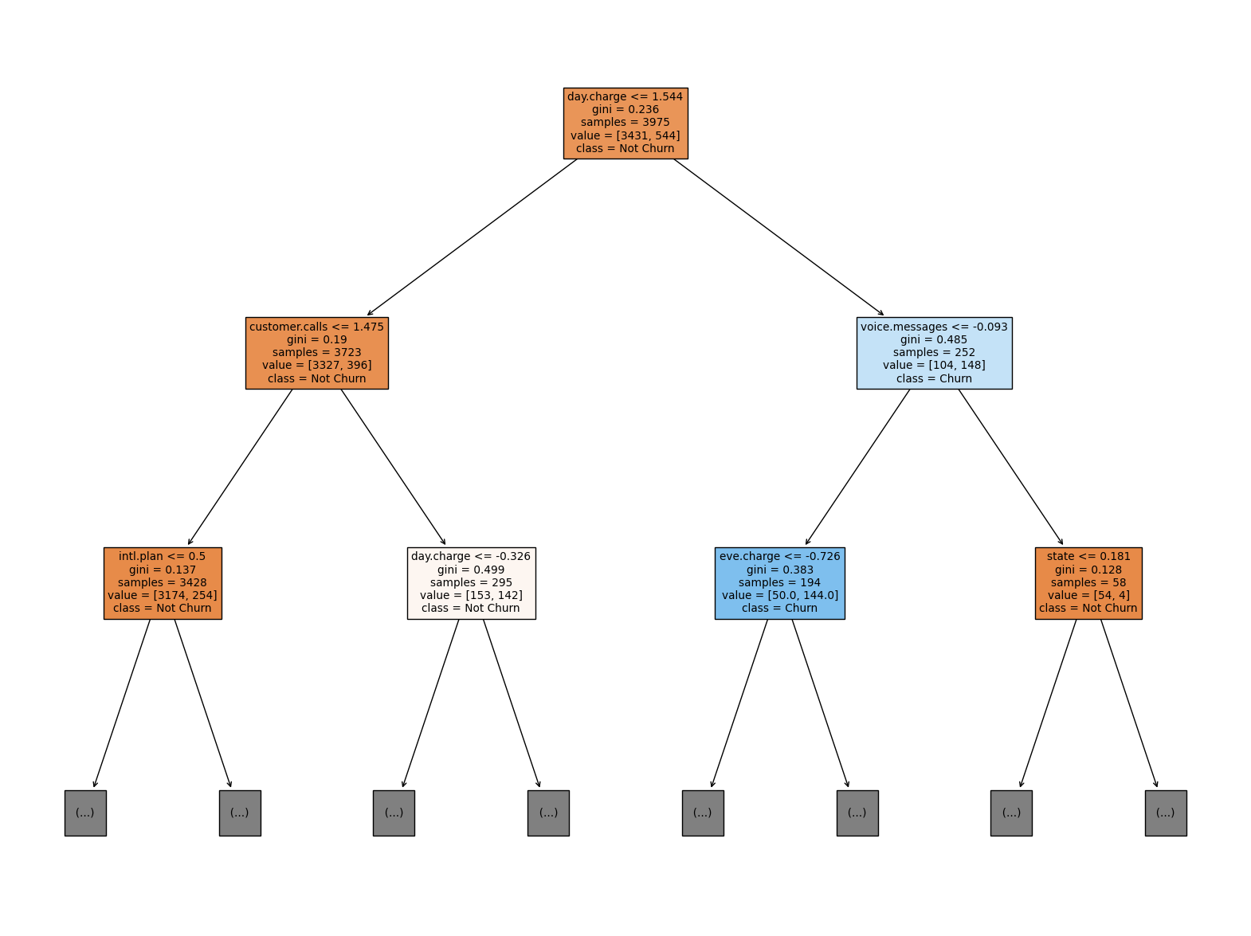

Slide 23
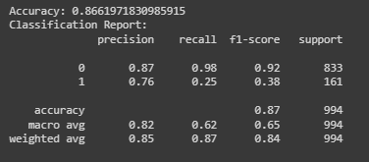
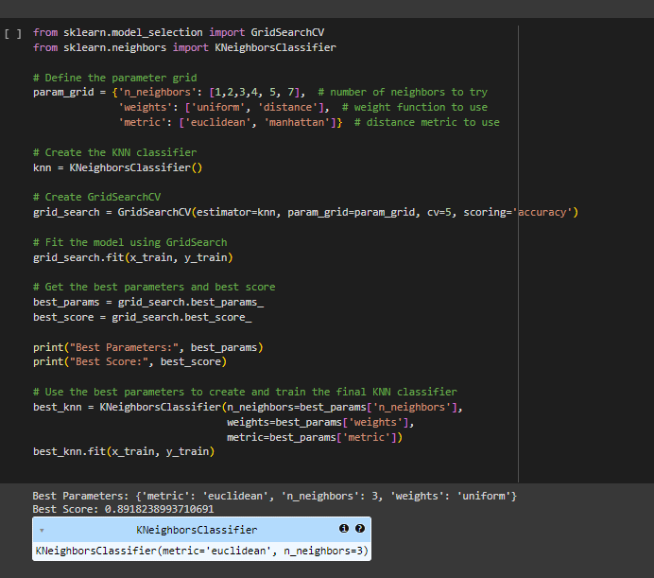
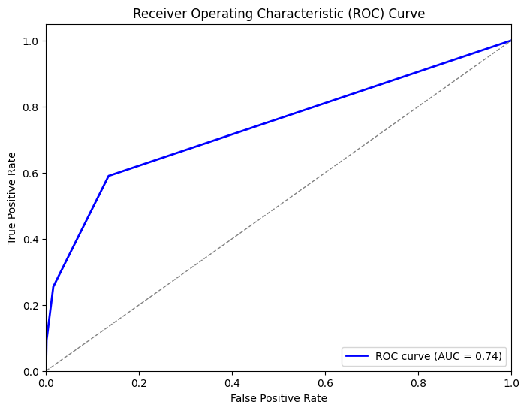

(3) KNeighbors Classifiers

Slide 24


Slide 25
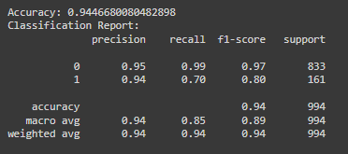
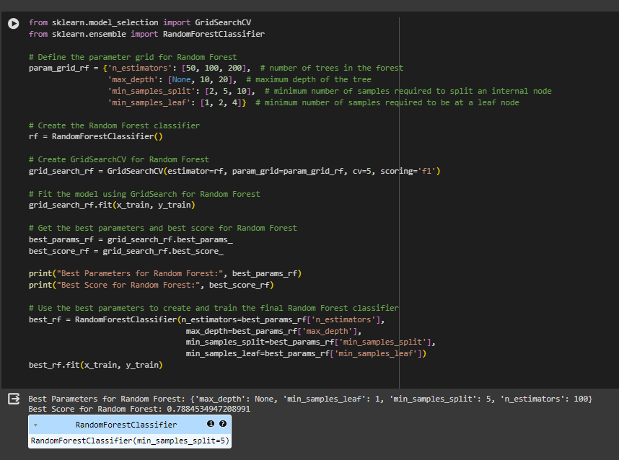
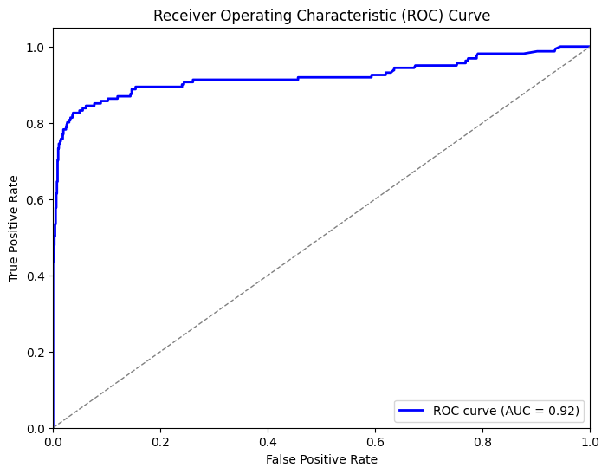
(4) Random Forest Classifier

Slide 26
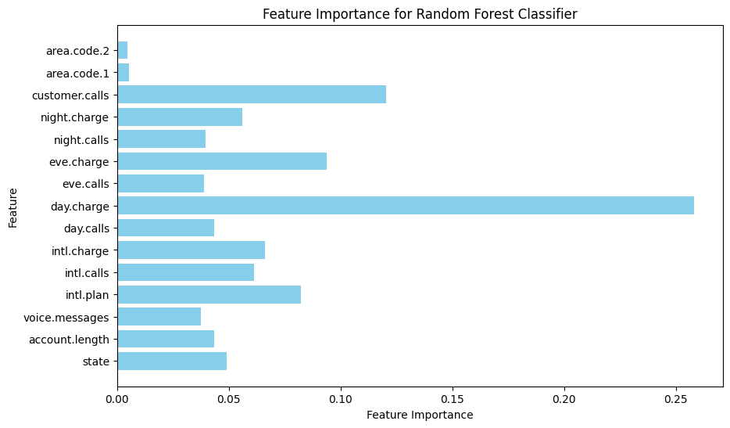

Slide 27
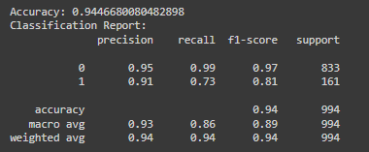
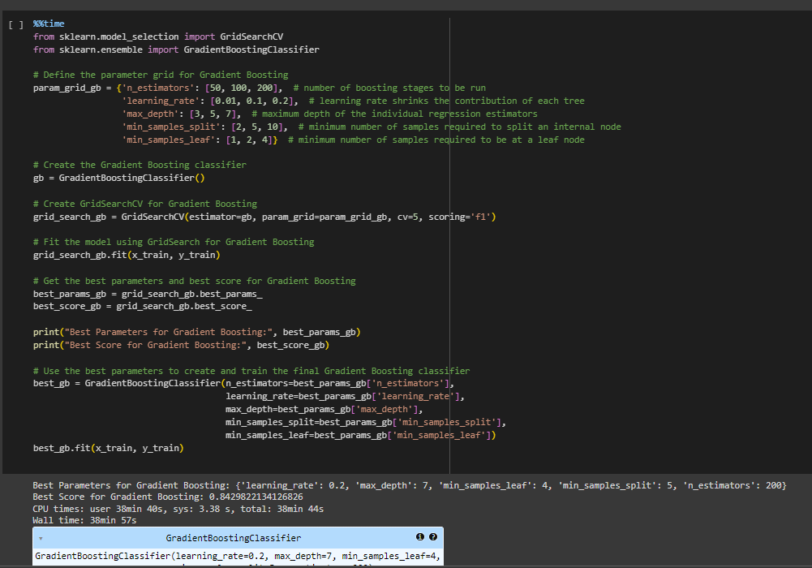
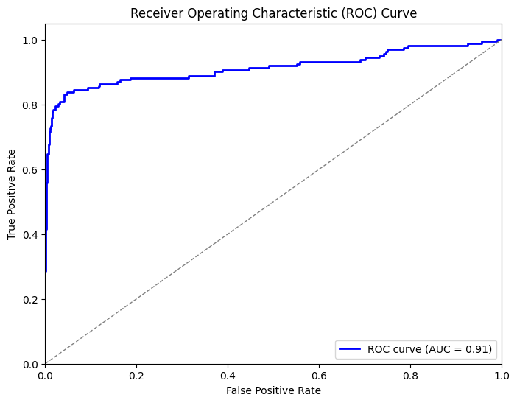
(5) Gradient Boosting Classifier

Slide 28
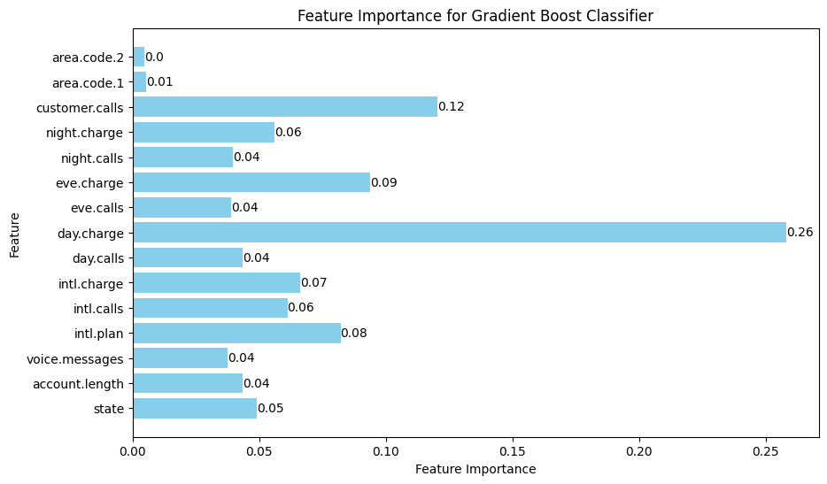

Slide 29
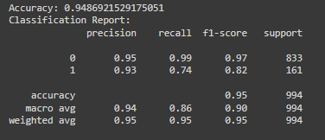
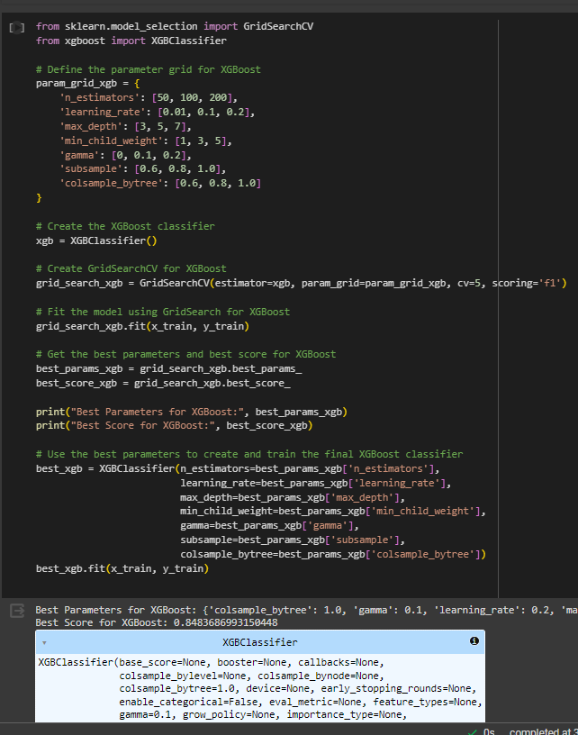
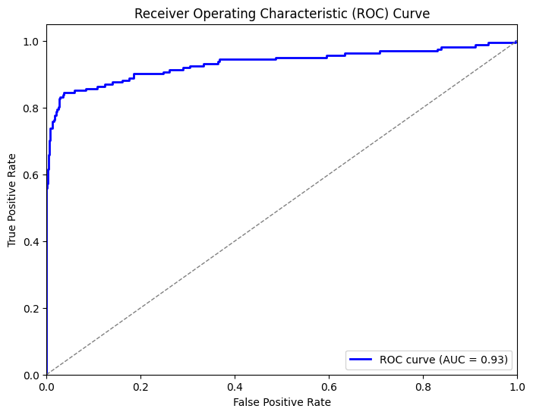
(5) XGradient Boosting Classifier

Slide 30
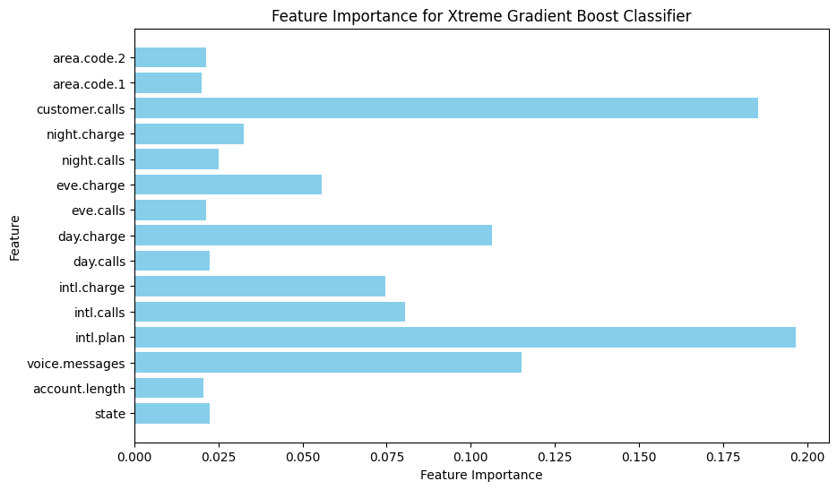

Slide 31
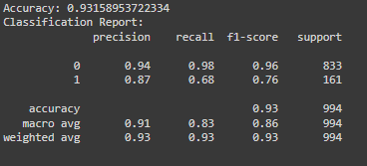
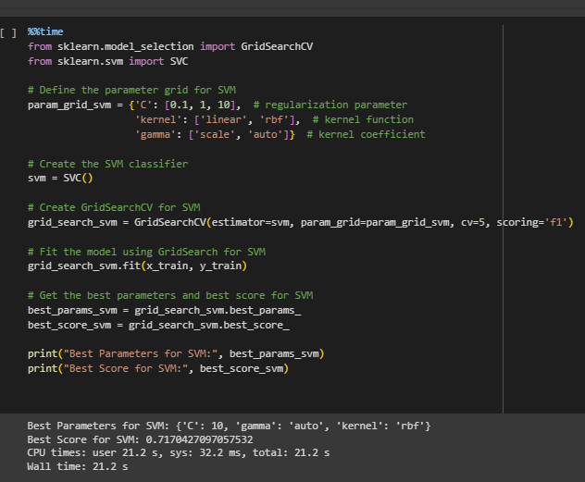
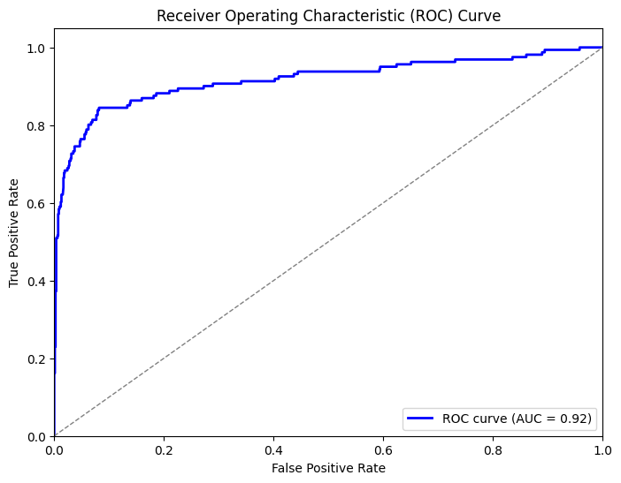
(5) SVC

Slide 32
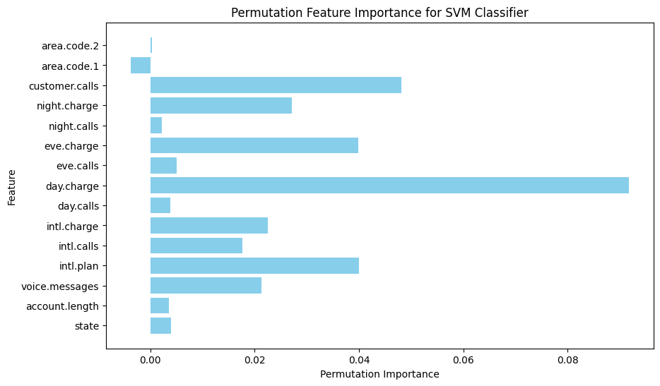

Slide 33
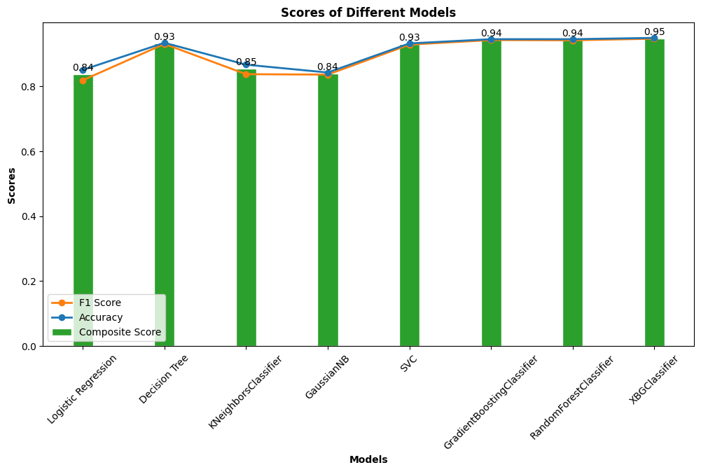

Slide 34
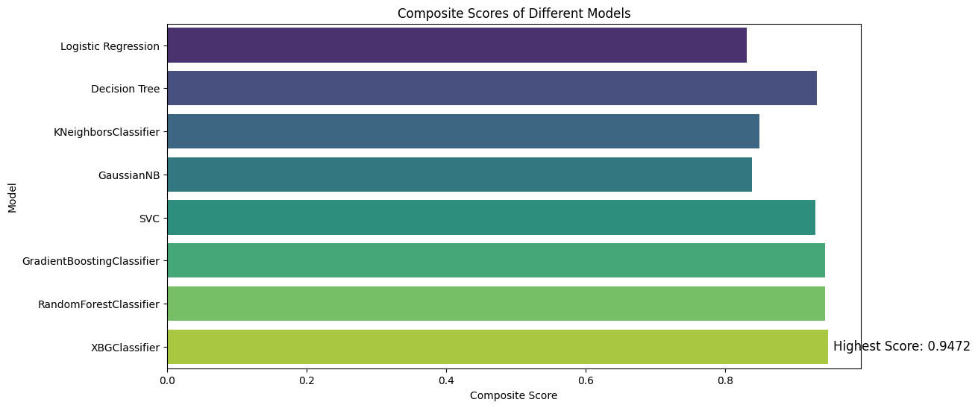

Slide 35
Deployment
Raw Data Pre-Processing
In Deployment

Slide 36
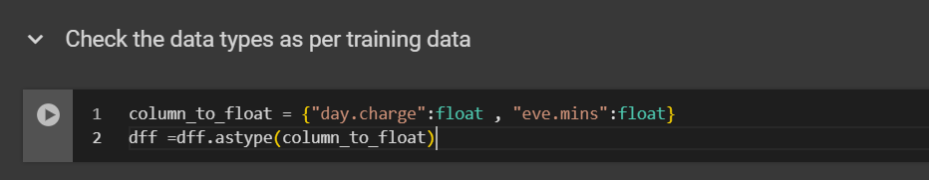
Data Consistency
Check Whether the data types are Consistent using the info() function in Pandas.
We are not looking for the null values and duplicate values at this testing stage .

Slide 37
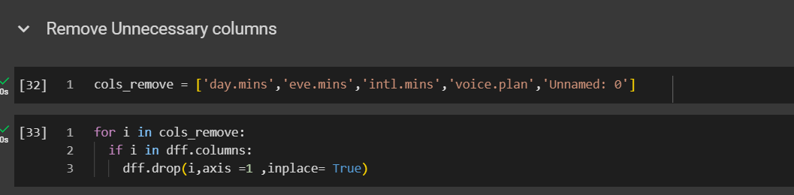
Remove Unnecessary Columns
“Unnamed: 0 “ does not contribute in positively inside the model.
Dimensionality Reduction
“Day.mins”,”eve.mins”,”intl.mins”,”night.mins” have high correlation value and are dependent values.
“voice.plan” and ‘“voice.messages” are dependent variables.

Slide 38
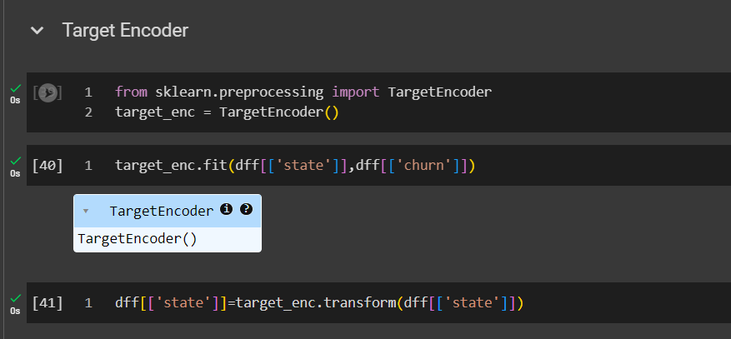
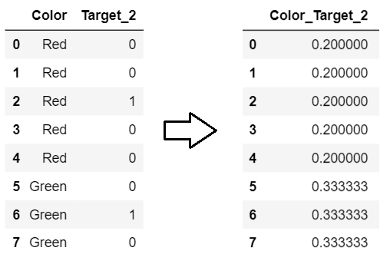

Target Encoding
It is powerful feature encoding techniques converts the categorical variables into numerical variables.

Slide 39


One Hot Encoding
It is a feature encoding techniques converts the categorical variables into numerical variables.
It creates a new features as many as unique types in categorical features.
It is being used for nominal categorical features .

Slide 40

Simple Standard Scaler
A simple standard scaler transforms features by subtracting the mean and dividing by the standard deviation, ensuring that the transformed features have a mean of 0 and a standard deviation of 1.
It is commonly used in machine learning pipelines to standardize numerical features, making them comparable and preventing certain features from dominating the model training process.

Slide 41

Data Correlation Matrix in deployment model.

Slide 42

Streamlit code

Slide 43

CONFUSION MATRIX FOR GB_MODEL

Slide 44

Streamlit code

Slide 45

7. Inference and actionable insights

Slide 46
THANK YOU

